Slide 1

WNBA
Notes:
Roos
Good afternoon everyone! Today we are going to talk about the WNBA short for Women's National Basketball Association. To be honest, before this project, we knew nothing about basketball in general. So we did the first sensible thing anyone in our position would do.

Slide 2
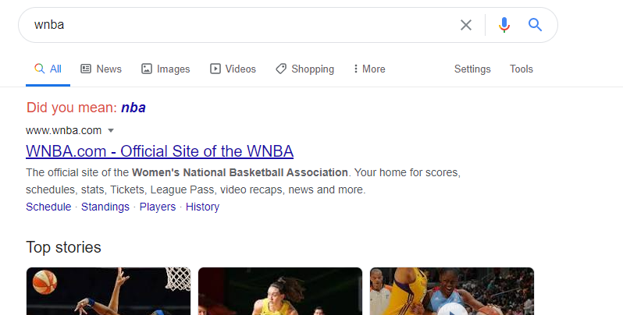
*Not a real google search
Notes:
Roos
We Googled WNBA. Not to confuse with with NBA. Whereas the NBA is popular since 1946, the WNBA was founded only 24 years ago.

Slide 3
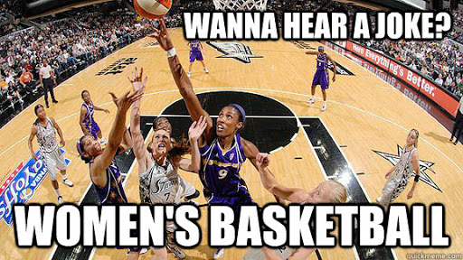
Notes:
Roos
And even though people still make fun of the WNBA, their level of professionalism is no joke.
Fergus
Yeah? Well I did some searching of my own...

Slide 4
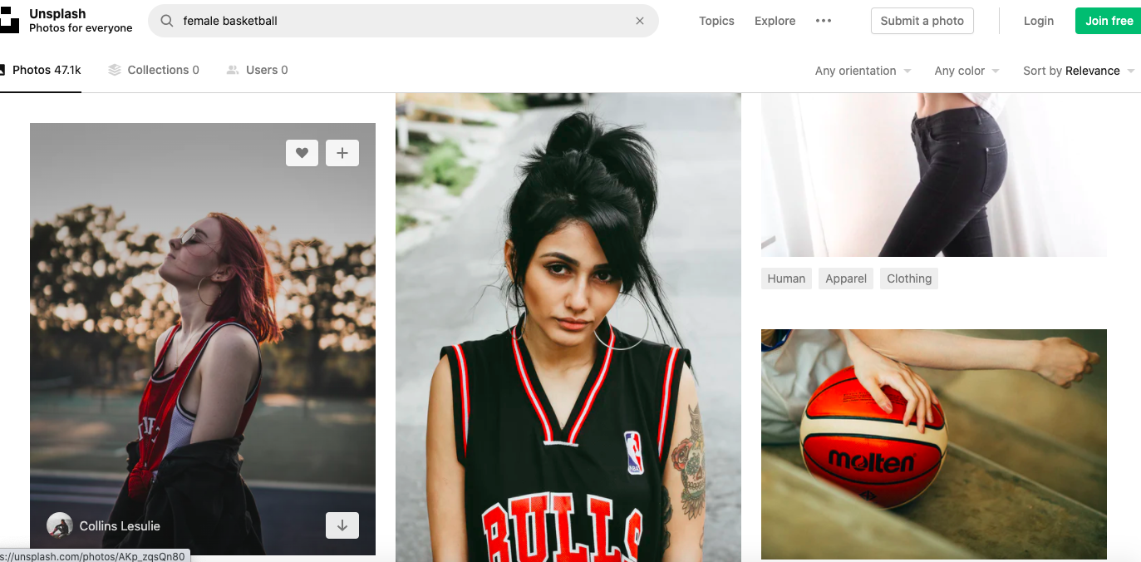
*This is a real search though
Notes:
Fergus

Slide 5

Notes:
Fergus

Slide 6



Notes:
Fergus

Slide 7

Notes:
Fergus

Slide 8

Notes:
Fergus

Slide 9
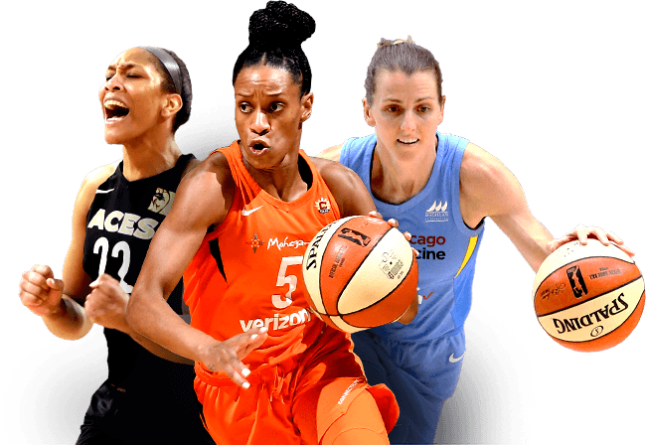
Notes:
Veeka
Let’s take a more closer look, When I googled women’s basketball this is what I get - strong, determined and powerful women

Slide 10
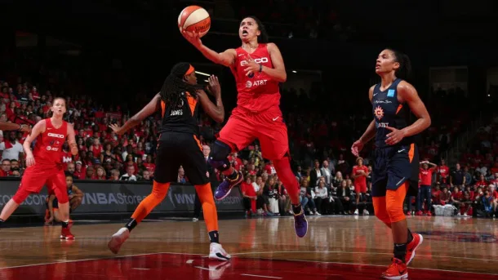
Notes:
Veeka
Look at that jump

Slide 11
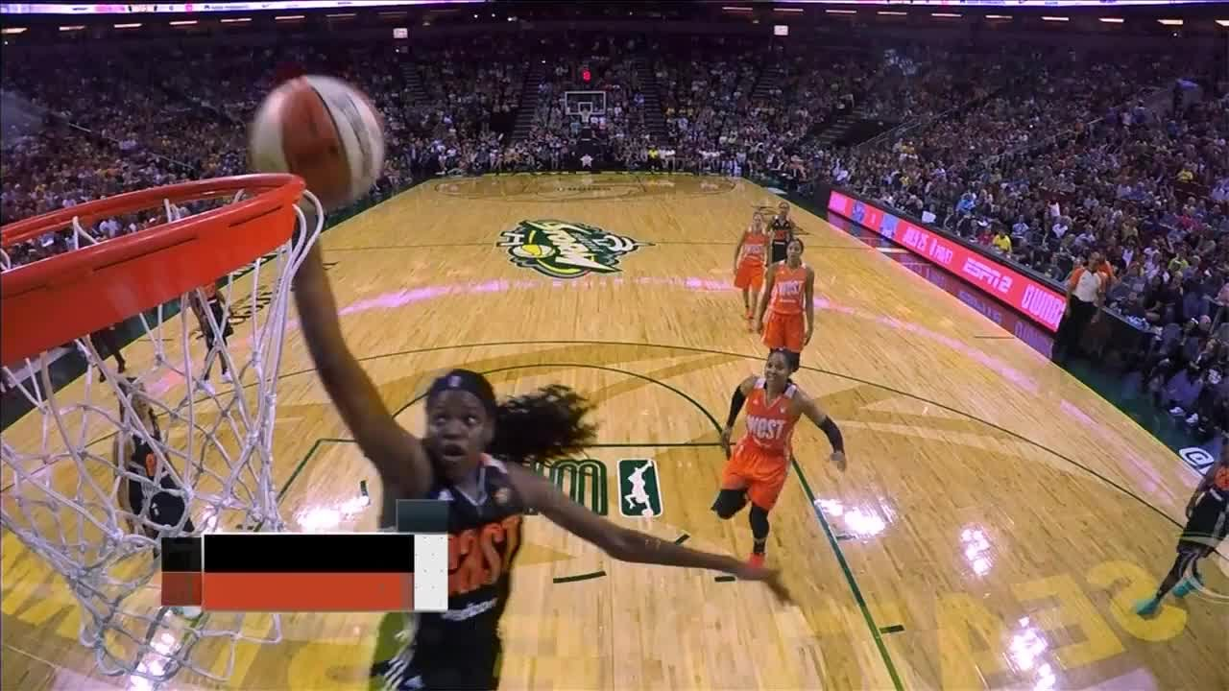
Notes:
Veeka
And this dunk is very impressive

Slide 12
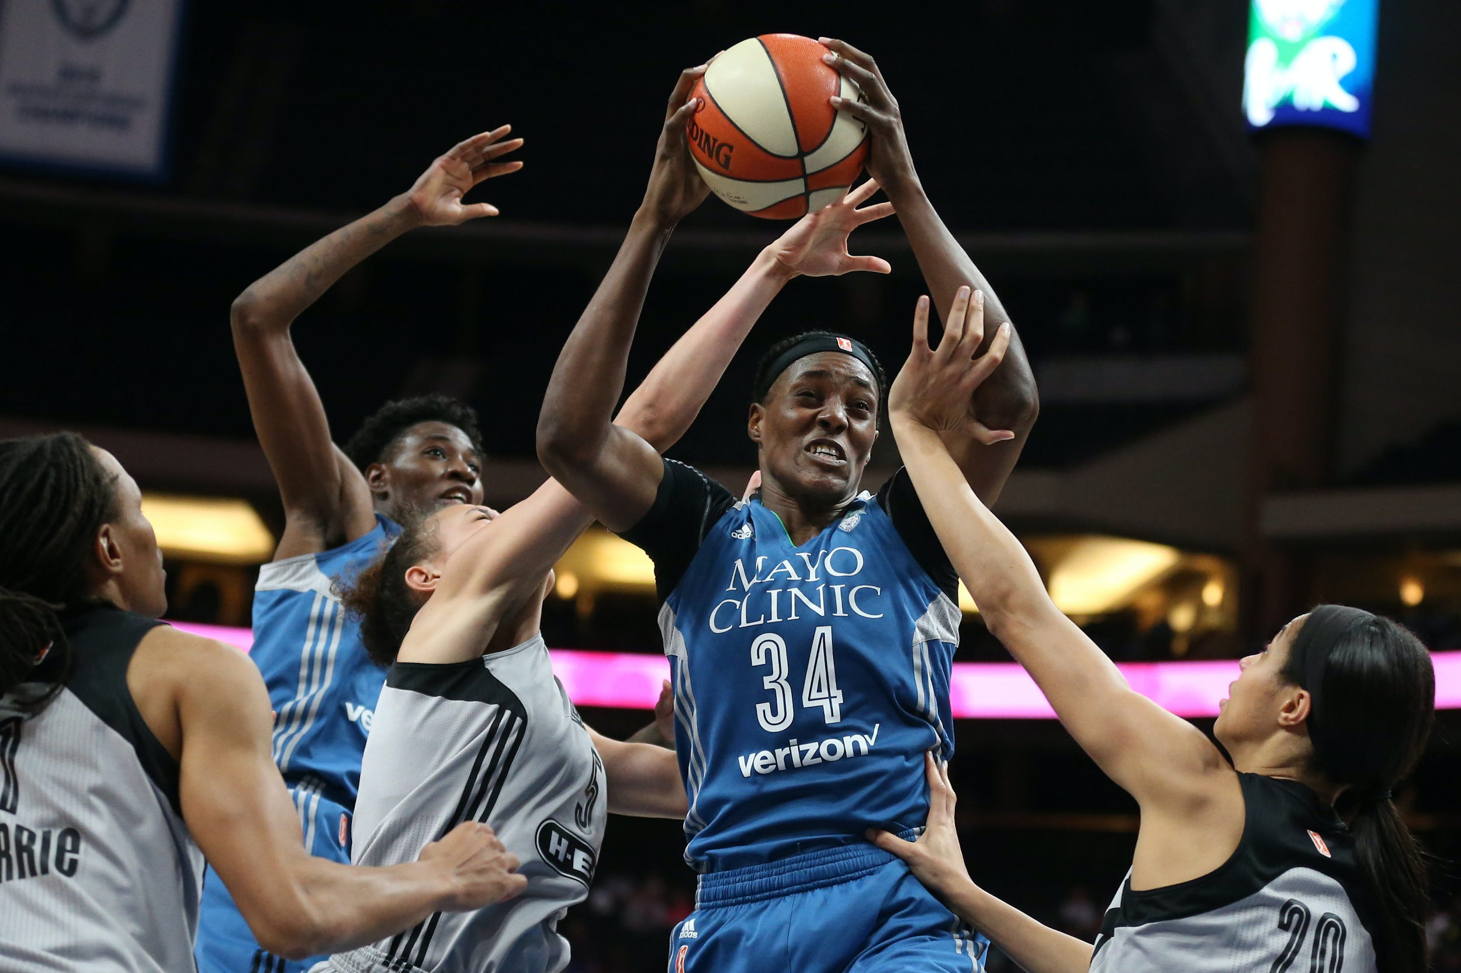
Notes:
Veeka
And here - What a force!
Fergus -
Roos - So normally I’d say a picture is worth a thousand words, but these pictures we have just seen do not seem to represent the reality.

Slide 13



Don’t believe pictures. Believe data!
Notes:
Roos
So normally I’d say a picture is worth a thousand words, but these pictures we have just seen do not seem to represent the reality.
I guess we can alI agree that making jokes about women’s basketball is very outdated…
So when we got the opportunity to analyse the dataset of WNBA players, we took it very seriously. When we started to analyse the dataset and grouped the data per basketball team, we found a significant difference for one specific team. The team that stood out of the others was the Minnesota Lynx. And can you guess what variable made them stand out?

Slide 14
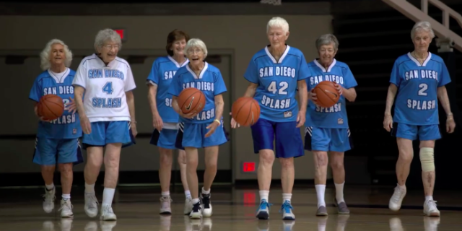
Notes:
Roos
The players age!
So yes, we were surprised to see that the team members of the Minnesota Lynx are respectively older than the others. Let’s have a look at the data.

Slide 15

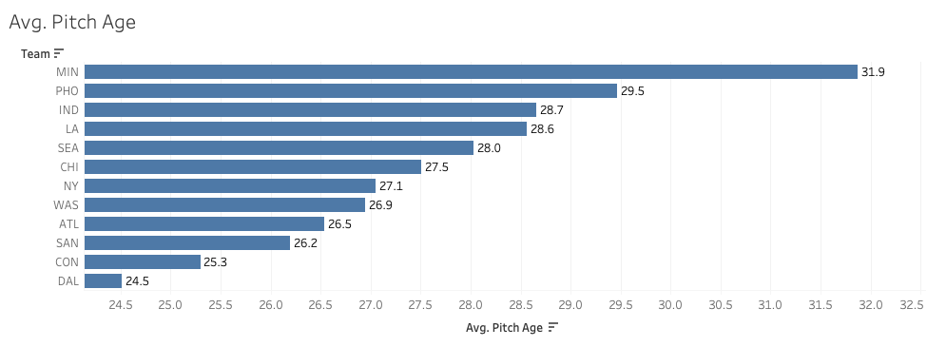

Avg. age on the court
‘Oh my!’
Number of players
23
25
26
27
31
32
33
34
35
years old
Notes:
Roos
On this graph you can see the 12 basketball teams on the left side with the average age on the court of each team on the x axis.
Clearly the first team, Minnesota, has the highest average age of almost 32 years. In other words, Minnesota is nearly 5 years older than the other teams in the league!

Slide 16

So what?
Who cares?
Notes:
Roos
So what? Who cares that Minnesota has a high average age? That is the question we asked ourselves. We got intrigued and decided to look into their success in the league.

Slide 17
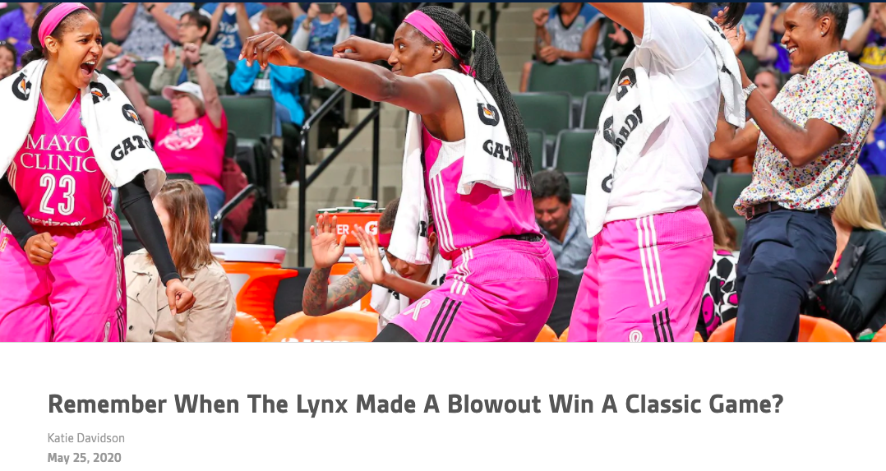
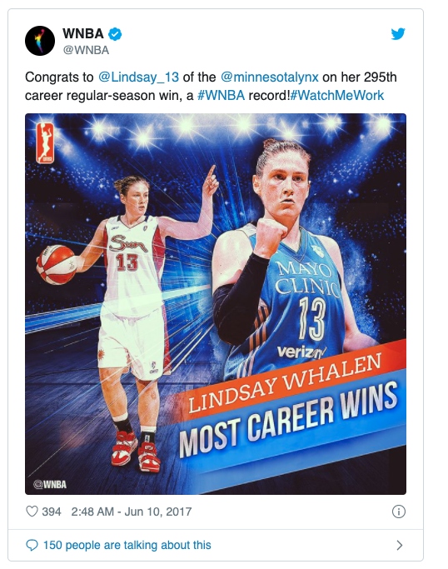

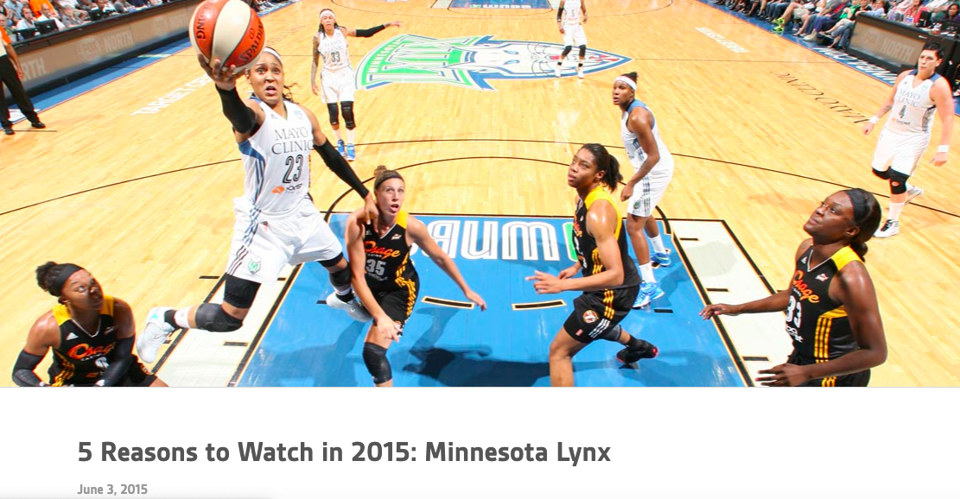
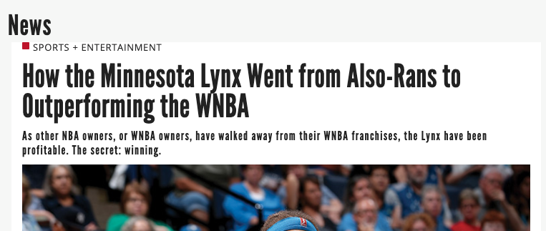
OId but gold?
Notes:
Veeka
They had major success throughout the years. Prior to 2017, they won 3 out of the last 6 seasons. It appears that they are not doing badly.

Slide 18
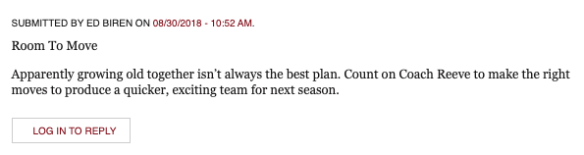
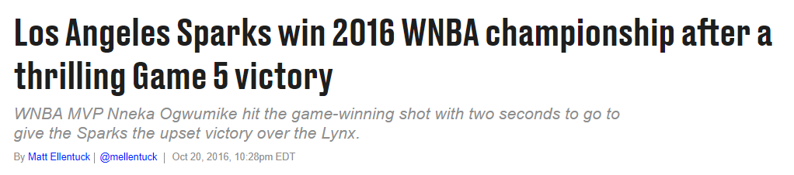
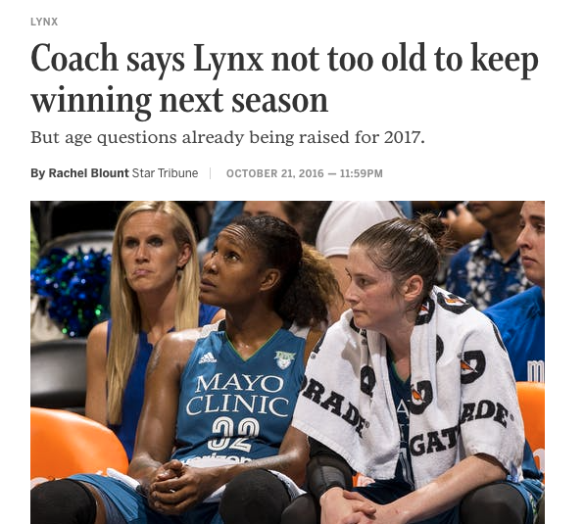
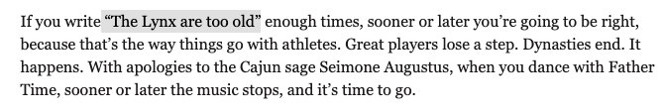
But how long can it last?
Notes:
Veeka
In 2016, a year prior to their winning season they came close second, only losing by a single point with 3 second to go to LA Sparks.
So, how long can this winning streak last?

Slide 19



What makes a great team?
Oh, hell no!
Notes:
Roos
So today we will compare the Minnesota team to the other teams and we will try to find out what makes Minnesota such a great team.
Did they score the most points? Do they play extremely defensive? Or do they have the majority of control? Let’s find out.

Slide 20
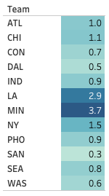


Win/Loss Ratio
Notes:
Roos
Let’s start by looking at this table. This table shows a list of the 12 teams and their win to loss ratios. Minnesota has a ratio of 3.7 meaning that for every lost game, Minnesota won 3.7 games on average. So this looks very promising, right?

Slide 21
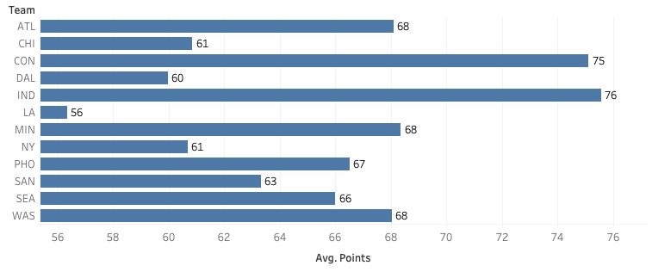

Average Points Scored per Game
Notes:
Roos
This graph shows an average points scored per game. Here you can see that Minnesota scored 68 points per game on average. Interestingly enough, whereas in the last slide Minnesota clearly had the best win/loss ratio, on this slide they do not seem to stand out.
So let’s continue to look into some other statistics to find out why they are such a great team.

Slide 22
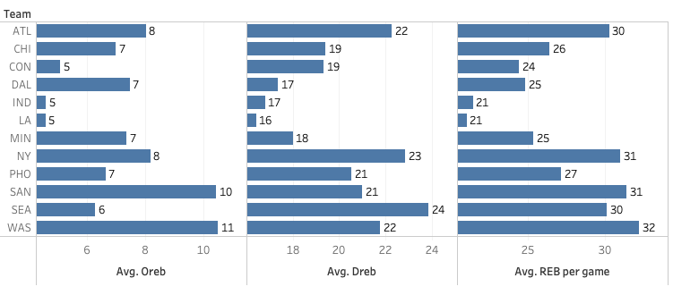

Offensive, Defensive,Total Rebounds per Game
Offensive Rebounds
Defensive Rebounds
Total Rebounds
Notes:
Veeka
Ths graphs shows average offensive, defensive and total rebounds per game. On all categories Minnesota is simply….an average team

Slide 23
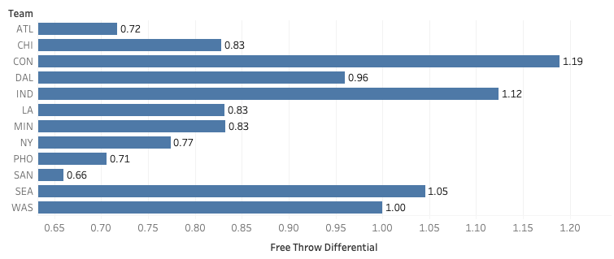

Free Throw Differential
Notes:
Veeka
This graphs compares 3 Points Attempts to Free Throws Attempts which tells us which team is more aggressive in terms of attacking the basket and getting the ball inside. Minnesota’s ratio is not so compelling compared to the other teams and once again they are in the middle.

Slide 24
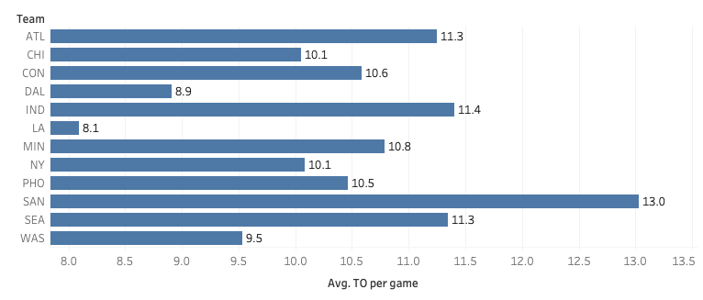

Turnover per Game
Notes:
Veeka
This graph tells us an average number of giveaways of possession per game and once again Minnesota is in the middle.

Slide 25
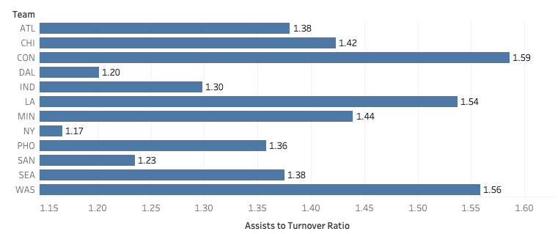
Assists to Turnover Ratio
Notes:
Fergus
This graph shows the ratio of assists to turnovers. This is an indication of how well the team is finding open players and completing passes. Minnesota again is fairly average.

Slide 26
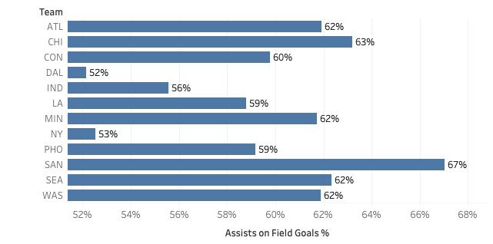

Assists on Field Goals
Notes:
Fergus
This graph tells us how well a team moves the ball and finds an open player. Minnesota does pretty well, but they are not the best.

Slide 27
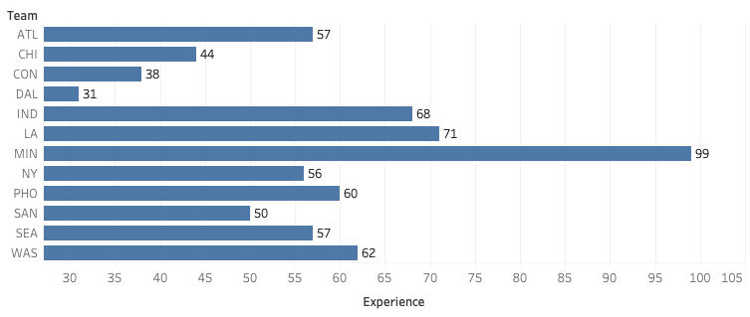

Years of Experience
Holy Cow!
Notes:
Fergus
This graphs tells us combined years of experience and once again...Wait a minute! We have a winner! Minnesota are the oldies in the group with more than 3 times of combined experience of the Dallas Wings.

Slide 28


What does make a great team?
Notes:
Veeka
Despite despite looking at one season, we believe that Minnesota Lynx are a great team.
It’s important to recognize that here are some stars on the team including Seimone Augustus, Rebekkah Brunson, Maya Moore who were voted Top 20 Players of All Time.
Stars yes but a great team effort is still required
Looking at each of their stats, they tend to be not the best and not the worst in their league.
But their age and experience in cunning makes them stand out
Most importantly, we believe that “Champions will find a way”

Slide 29

How did the season go?
Notes:
Fergus

Slide 30
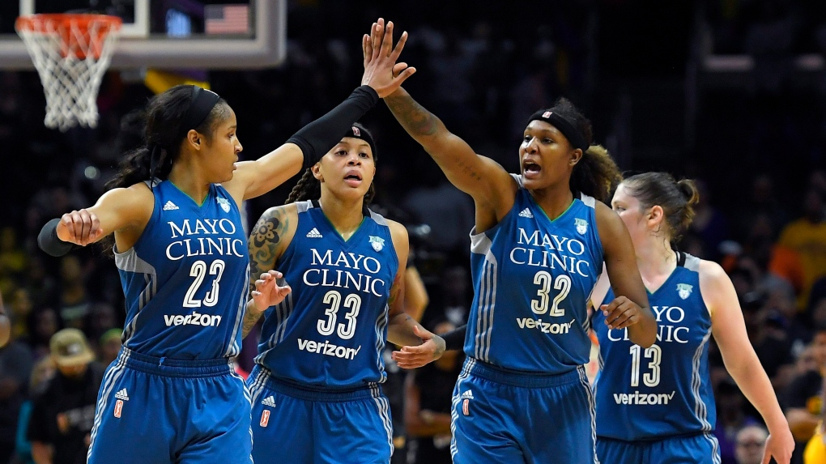
Top of Western Conference
33 wins, 9 losses
Notes:
Fergus

Slide 31
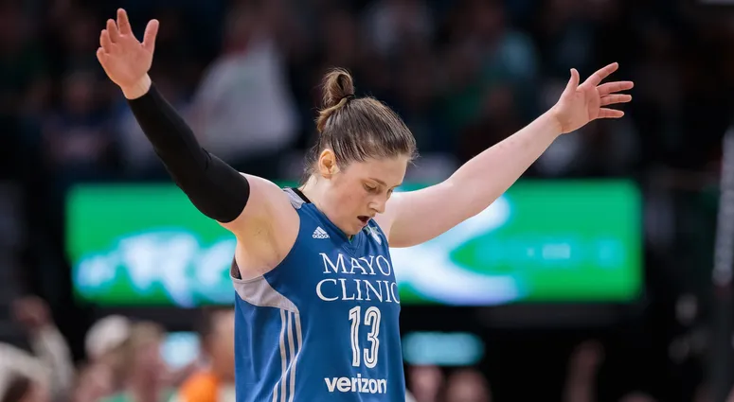
Most wins in WNBA (295 games)
Lindsay Whalen
Notes:
Fergus
Lindsay Whalen became the player with most career wins WNBA history

Slide 32
Quartet with most WNBA wins (122 games)
Seimone Augustus, Rebekkah Brunson, Maya Moore and Lindsay Whalen
Notes:
Fergus
And the quartet of Seimone Augustus, Rebekkah Brunson, Maya Moore and Lindsay Whalen became the quartet with most career wins in WNBA history at 122.

Slide 33
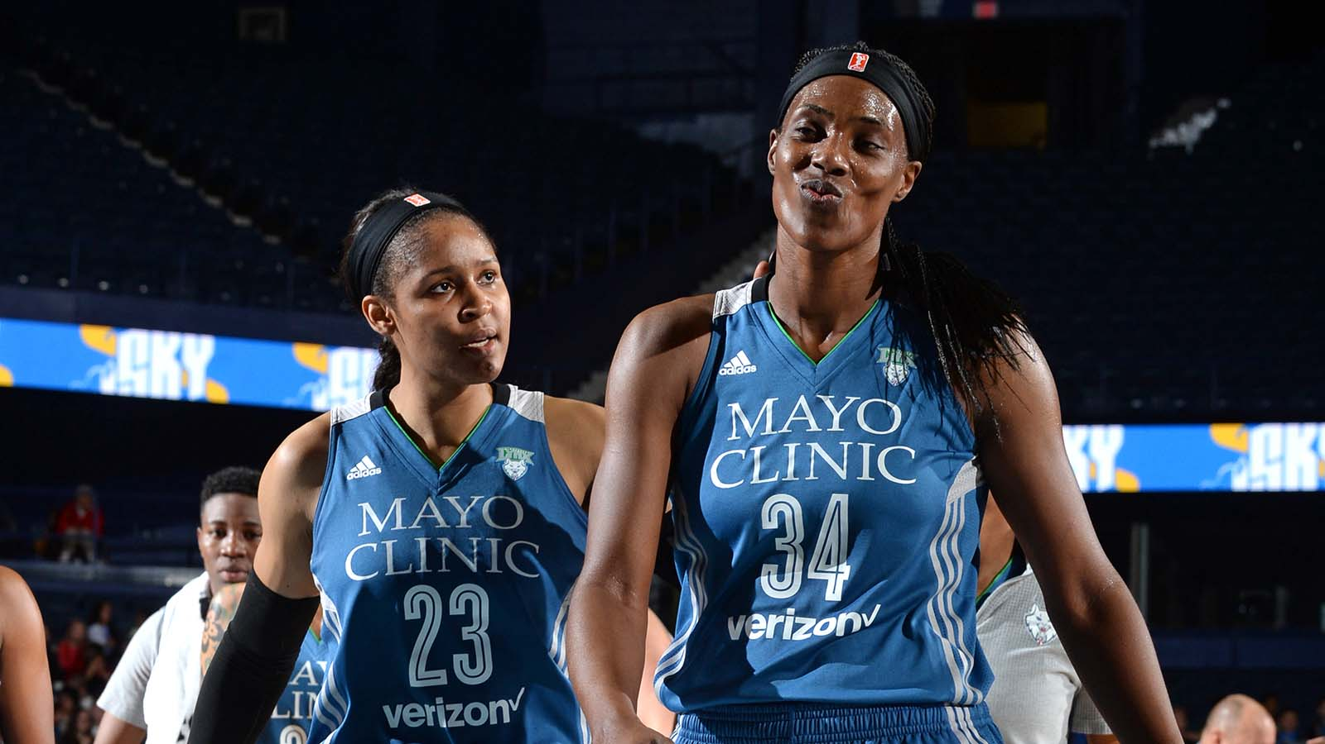
WNBA Most Valuable Player Award
Sylvia Fowles
Notes:
Fergus
For that season, Sylvia Fowles was voted WNBA Most Valuable Player Award receiving 35 of the 40 votes.

Slide 34
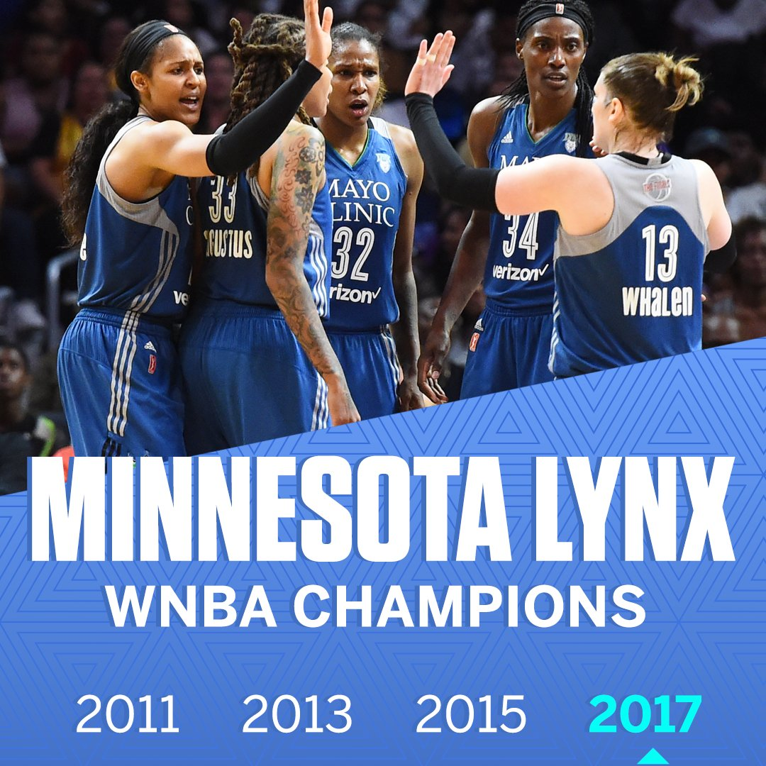
Notes:
Fergus
And last but not least, they won the league getting revenge on LA Sparks in a rematch of the 2016 final.

Slide 35
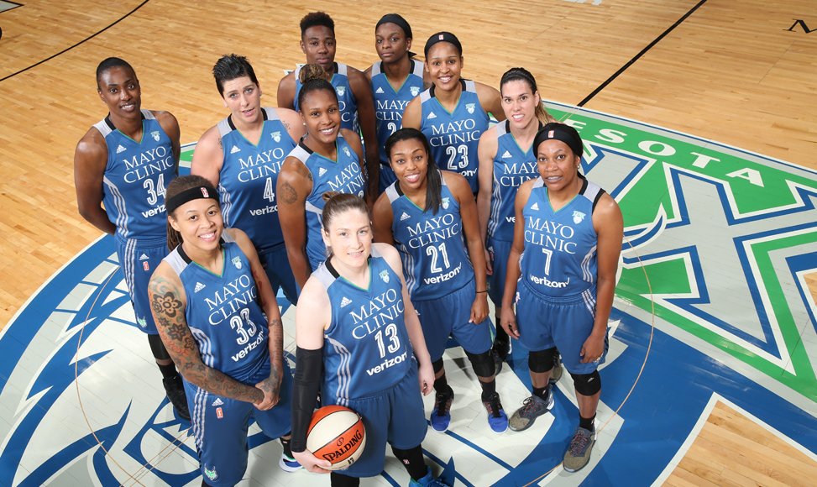
End of an Era
Notes:
Fergus
End of an era. Sadly after being asked year on year how long they would stay at the top, this championship would be their last.
In 2018 and 2019, the team failed to pass the first elimination round. But despite this, they will be remembered among the greatest teams to have ever played in the WNBA.

Slide 36

End of a Presentation
Thank you!
Any questions?
Notes:
Fergus
Talking of end of an era, it’s also the end of a presentation. I want to thank my two beautiful assistants, Veeka and Roos. I’ve been Fergus. Thank you and goodnight.

